Slide 1

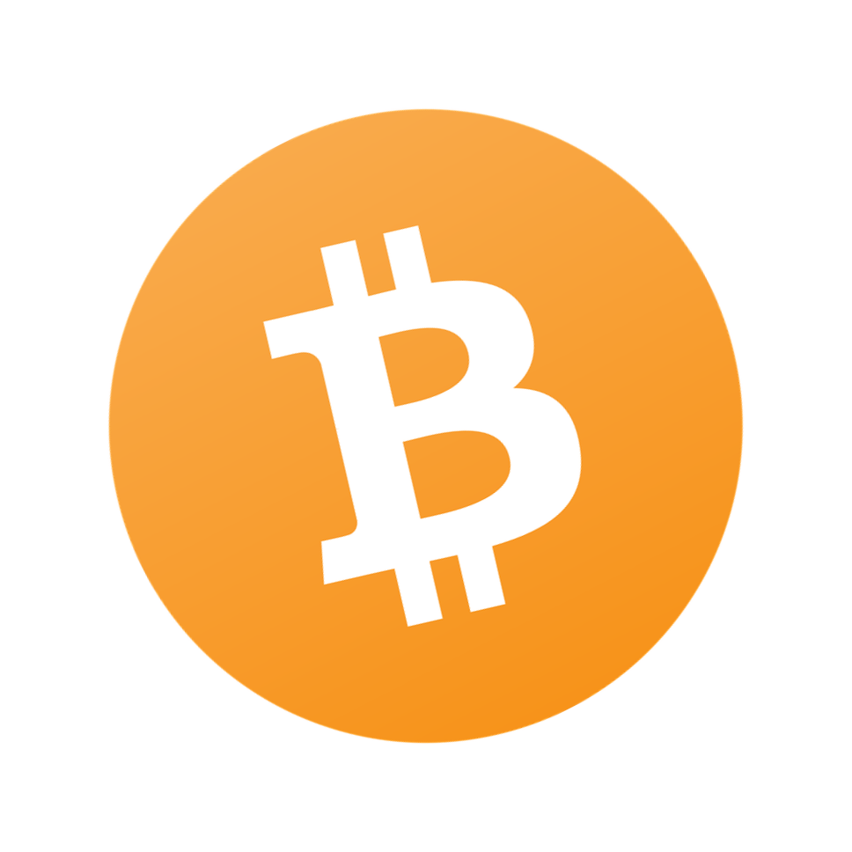
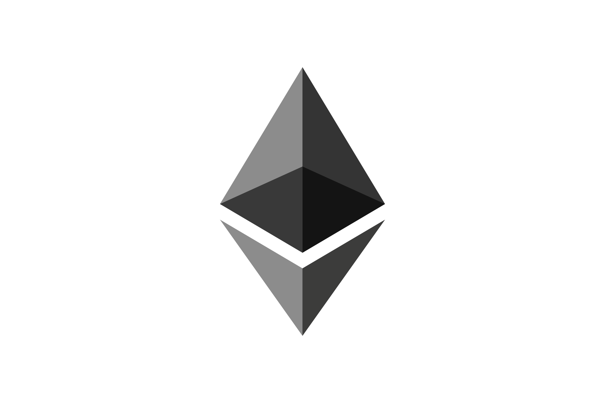
Blockchain
Technology
Presented to Professor Radha Parikh
Presented by Archit Agrawal

Slide 2
What is a Blockchain?
It is a decentralized, distributed ledger that records the information of an asset and makes it difficult or nearly impossible to change it.

Slide 3
A common
misconception
Bitcoin is not a Blockchain

Slide 4
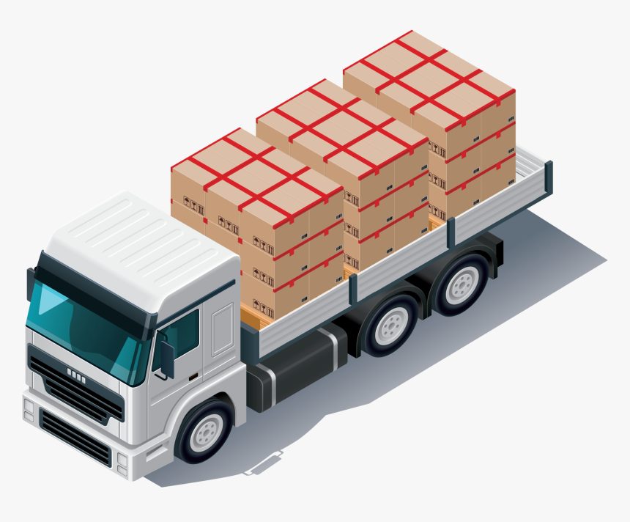

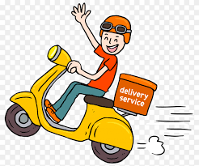
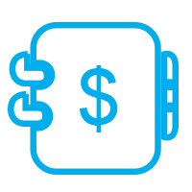
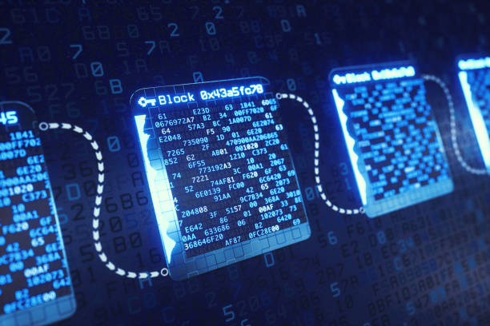
What is a Blockchain?
Ledgerr
A blockchain

Slide 5
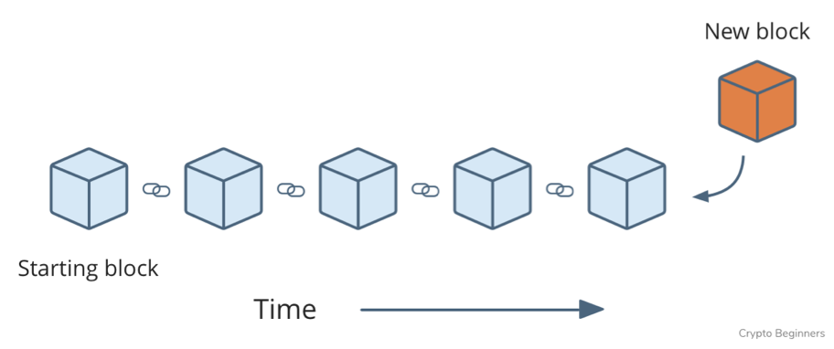
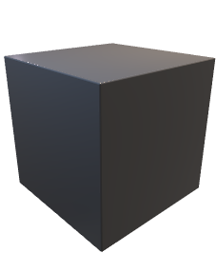
Why is it called Blockchain?
Relevant Information depending on use case
Hash
Hash of Previous Block

Slide 6
Why Blockchain?
Decentralized Structure
Distributed Ledger
Reduces Corruption
Efficiency and Speed
Reduced Costs
Trust
Improved Security and Privacy

Slide 7

Decentralized Structure
P
Q
P
Q
No third party required

Slide 8
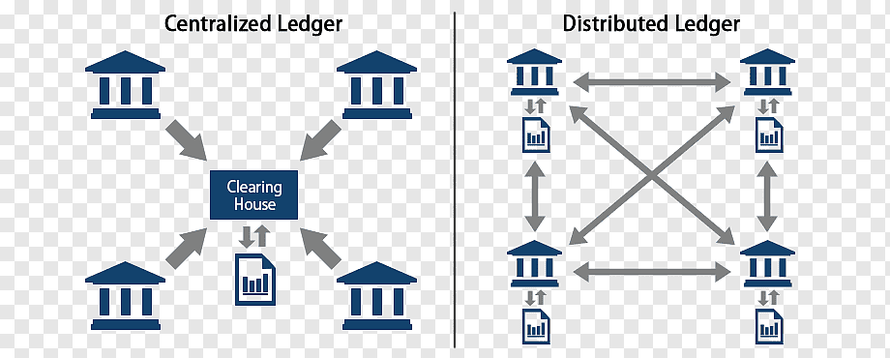
Distributed Ledger

Slide 9
How is blockchain cheap and efficient?

Slide 10
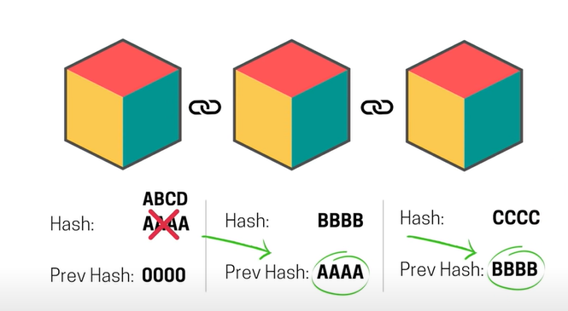
Improved Security and Privacy
Proof of Work – It is a form of cryptographic proof in which one party proves to others that a certain amount of computation effort has been expended.

Slide 11
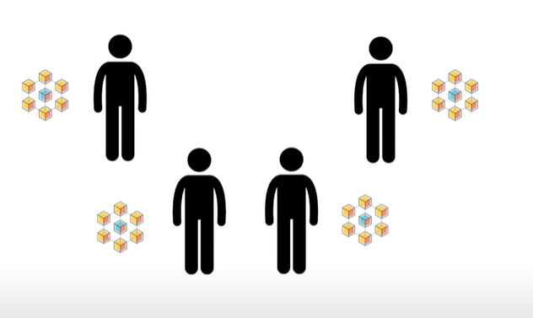
Improved Security and Privacy
Consensus Algorithms - A consensus algorithm is a procedure through which all the peers of the Blockchain network reach a common agreement about the present state of the distributed ledger.

Slide 12
Where is Blockchain Technology used?
Cryptocurrencies
Real Estate
Hospital Management System

Slide 13
THANK YOU

